Slide 1

Machine Learning in R
https://docs.hpc.arizona.edu
Research Technologies

Slide 2
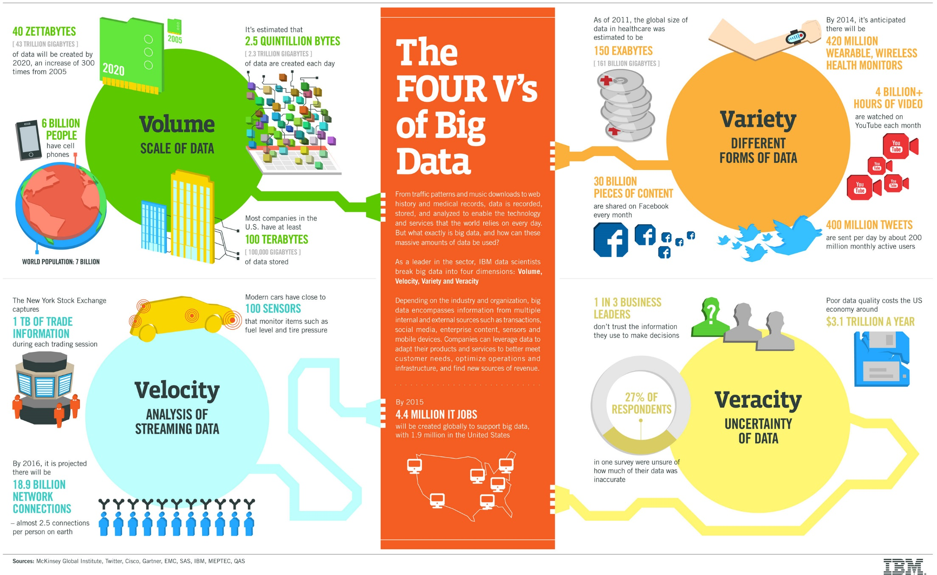
Machine Learning with R
Research Technologies
Chris Reidy

Slide 3


Knowledge Discovery Process
The Knowledge Discovery process takes 7 steps
Step 1: Understand your business goal and your data
Step 2: Select your data
Step 3: Prepare and process your data
Step 4: Transform your data
Step 5: Data mining
Step 6: Analyze, interpret the data and patterns
Step 7: Knowledge creation and presentation
Step 1
Understand Data
Step 2
Select Data
Step 3
Prepare and process Data
Step 4
Transform Data
Step 5
Data Mining
Step 6
Analyze and interpret data
Step 7
Knowledge creation and presentation

Slide 4
Knowledge Discovery Process
STEP 1: Understand your business goal and your data
Depending on your specific goal, the model you choose will be different
Exercise: For an electronics store, what type of factors lead to high return rate?

Slide 5
Knowledge Discovery Process
STEP 2: Select your data
Figure out which data you need to solve your problem
This is important since preprocessing is very time consuming, you want to focus on that data that you will actually use
There will be problems when you get to this step (guaranteed!)
Incompatibilities in the databases or data files
Data may be incomplete
Data may be obscure
Note: this step can also come later (again)
Exercise: For the electronics store return rate problem, what data can we get (existing), could we create (start collecting)?

Slide 6
Knowledge Discovery Process
STEP 3: Prepare and process your data
Very time consuming
Data can come from legacy systems or external sources
The data will need to be
Cleaned, integrated
Selected (again)
There will be problems/issues
Incomplete: missing values or aggregates only
Noisy: missing, duplicated, erroneous or outliers
Inconsistent: birthday is 1 Jan 1993, 010193, 01-01-1993
Intentional: default values if not specified

Slide 7
Knowledge Discovery Process
STEP 3: Prepare and process your data
Nominal -> name
For a person: name, SSN, age, education
Some numbers can be used for calculation like age; and some cannot, like SSN
Some values are ranked: Cancer stages 1,2,3,4
Binary -> only two values
Boolean: True or False, organic or inorganic
Symmetric: if both values are equally important
Asymmetric: if one is more important – use 1 for more important
Numeric
Scale with units of equal size
Values can be +, -, or 0 (0 can be nothing or something like weight or temp)
Ratio scale
All characteristics of interval + true zero
Able to compute mean, median, standard deviation etc

Slide 8
Knowledge Discovery Process
STEP 4: Transform your data
Different type of transformations exist
Feature construction = applying mathematical formulas to existing data features
Feature subset selection = selecting which feature to use, which database columns to use
Aggregating data = sometimes, you will want to use only the average, or sum, or maximum, or minimum, or other groupings (per store, region, time unit)
Bin the data = breaking up continuous ranging in discrete segments (e.g. per month)

Slide 9
Knowledge Discovery Process
STEP 5: Data mining
Different models exist:
Pattern identification and description = link analysis, market basket analysis
E.g. People who buy soda, usually buy chips
E.g. People who visit website A, usually visit website B
Classification, prediction = supervised learning
E.g. if you work hard and you are smart -> you will get an A
Database segmentation, clustering = unsupervised learning:
E.g. documents covering the same topic (e.g., for similar documents, click here)
For each model, you can choose a method to build your model
Classification: decision trees, neural networks
Prediction: linear regression
For each method, you need to choose the algorithm
E.g. decision trees: ID3, C4.5, CART

Slide 10
Knowledge Discovery Process
STEP 6: Analyze, interpret the data and patterns
Once the model is build -> learn the implications
Sometimes visualization can help
e.g. clusters of documents, outliers
STEP 7: Knowledge creation and presentation
Use other resources to understand and interpret the end product
Tie back to original goal

Slide 11
Classification of Algorithms - Based on Technique
 | Characteristics | Pro | Con
Statistical Techniques e.g. regression analysis | usually involves numbers make strong assumptions about your model, e.g. normal distribution | elegant, theory based usually fast to train and test accurate tools available (SPSS, SAS, Minitab) results easy to understand | you need to know what to apply when need to be a good statistician (not an exact art :-) )
Symbolic Learning e.g. decision trees (ID3) | roots in AI decision trees, rules no assumptions made intuitive meaningful | very intuitive, easy to understand fast | not as accurate
Connectionist = Neural Networks FF/BP, SOM | black box approach flexible powerful combination of specialty graphs (=the data structure) + statistics | general purpose, can be applied to many problems can be super accurate (can also be a problem) | black box approach no intuitive results slow to train
Evolutionary = Genetic Algorithms | based on ‘survival of the fittest’ stochastic process | powerful for complex problems easy to implement relatively fast | problem representation (translation into GA) is hard to do
Heuristics/human based | learn from experience rules of thumb sometimes translated into expert systems | human judgment, insight (will be compatible) | variation of performance memory limitations information overload problems

Slide 12
Classification of Algorithms - Based on Goal
Descriptive Models
Link Analysis
Apriori algorithm
Clustering models
Hierarchical: Prim’s and Kruskal’s
Partitioning: K-Means
Density-based: DBSCAN
Grid-based: Self-Organizing Map (SOM)
Predictive Models
Classification (predict class)
Naïve Bayes
Decision Trees: ID3, C4.5
Ensemble Methods: Random Forest
Neural Networks: FF/BP
Support Vector Machines
Regression (predict number)
Optimization Models
Evolutionary programming (parallel search)
Genetic Algorithm (GA)

Slide 13
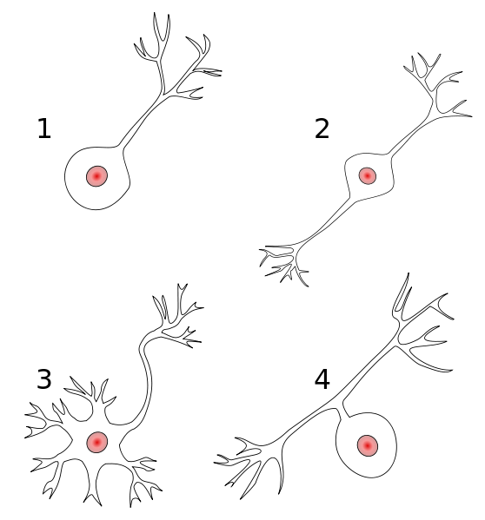
Neural Networks Relation to Biology
Synapses: connection to the next neuron (release of neurotransmitter)
Axon: delivers output from neuron to other neurons
Cell Body
Dendrites: to facilitate the connection with other neurons
Nucleus
Figure: Structure of a typical neuron

Slide 14
Neural Networks
o₁
o₂
o_{C}
…
w2₁₁
w2_{ij}
h₁
h₂
h_{B}
…
w1₁₁
…
w2_{ij}
w2_{BC}
w1_{ij}
w1_{AB}
Hidden Nodes
Output Nodes
x₁
x₂
x₃
x_{A}
Input Nodes

Slide 15
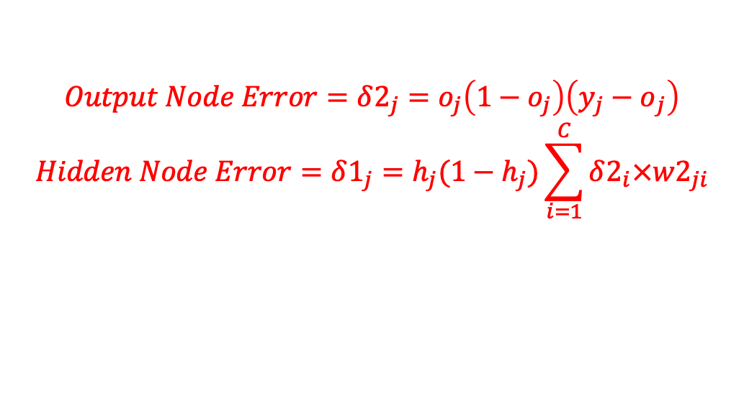
Backpropagation – the math
$$Output Node Error=δ2_{j}=o_{j}\left(1−o_{j}\right)\left({y_{j}−o}_{j}\right)$$
$$Hidden Node Error=δ1_{j}=h_{j}(1−h_{j})\sum_{i=1}^{C}{δ2_{i}×w2_{ji}}$$
x₁
h₁
o₁
h₁
o₁
o₁
o₁
o₁
x₂
o₂
h₂
o₂
o₂
o₂
h₂
o₂
x₃
…
…
…
o_{C}
h_{B}
o_{C}
o_{C}
h_{B}
o_{C}
o_{C}
x_{A}

Slide 16
Artificial Neural Networks
o₁
o₂
o_{C}
…
w2₁₁
A single perceptron (or neuron)
can be imagined as a Logistic
Regression.
An Artificial Neural Network is
a group of multiple perceptrons
at each layer.
ANN can be used to solve problems related to:
Tabular data
Image data
Text data
w2_{ij}
h₁
h₂
h_{B}
…
w1₁₁
…
…
w1_{ij}
w2_{ij}
w2_{BC}
w1_{AB}
Hidden Nodes
Output Nodes
x₁
x₂
x₃
x_{A}
Input Nodes

Slide 17
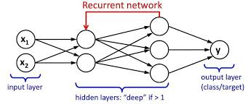
Recurrent Neural Networks
A looping constraint on the hidden layer of ANN turns it into RNN.
Parameter sharing results in fewer parameters to train and so reduces cost
RNN can be used for problems related to: Time series, Text or Audio data

Slide 18
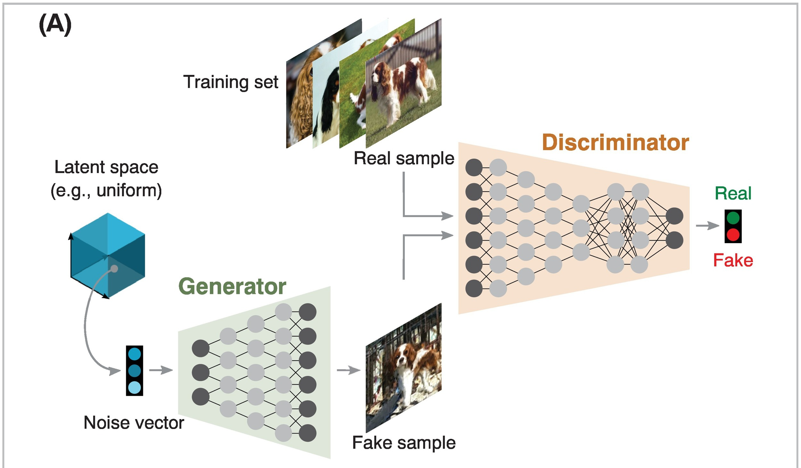
Generative Adversarial Networks
A double network with a generator that tries to fool the discriminator.
Used to generate images but also used in large particle physics on the LHC to create results close to the simulations without the very high compute cost.

Slide 19
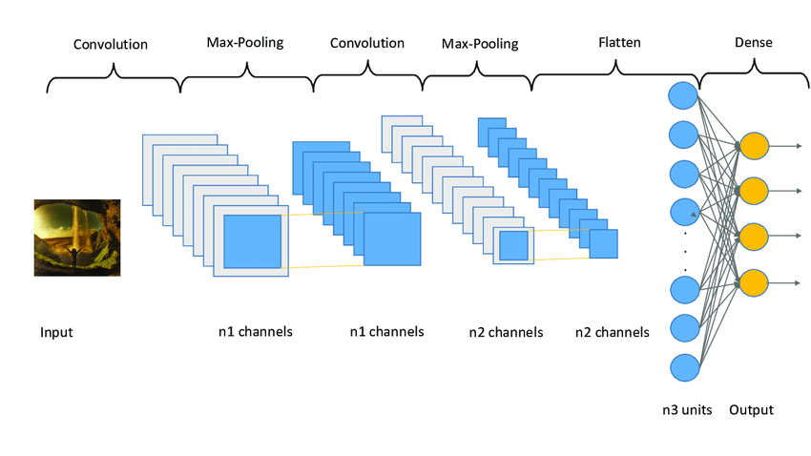
Convolutional Neural Networks
A filter extracts part of the visual data and creates a 3D array or convolution which are
passed to the pooling layer which reduces unnecessary features.
For image recognition, first layer detects gradients, second lines, third shapes etc
CNN can be used for problems related to: Image processing, Computer vision, Speech recognition

Slide 20
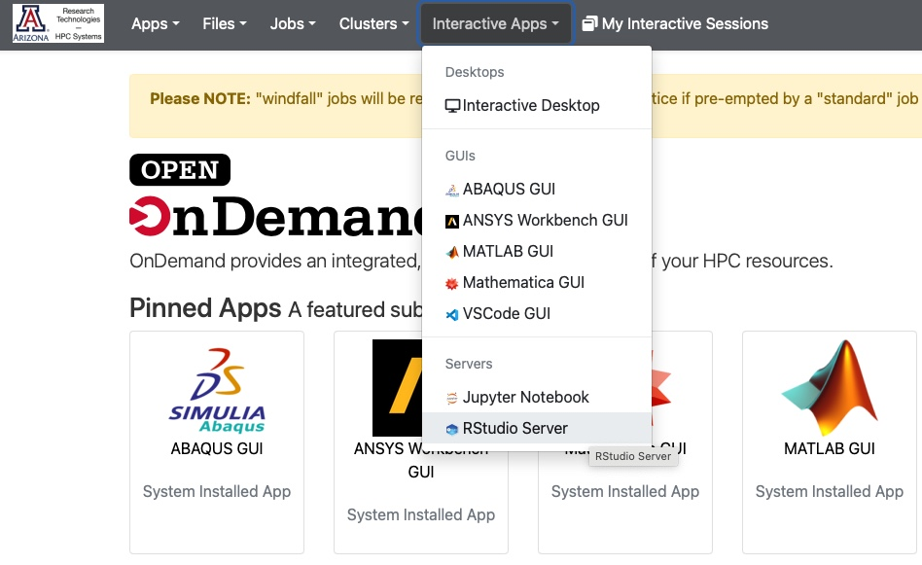
Using RStudio on HPC

Slide 21
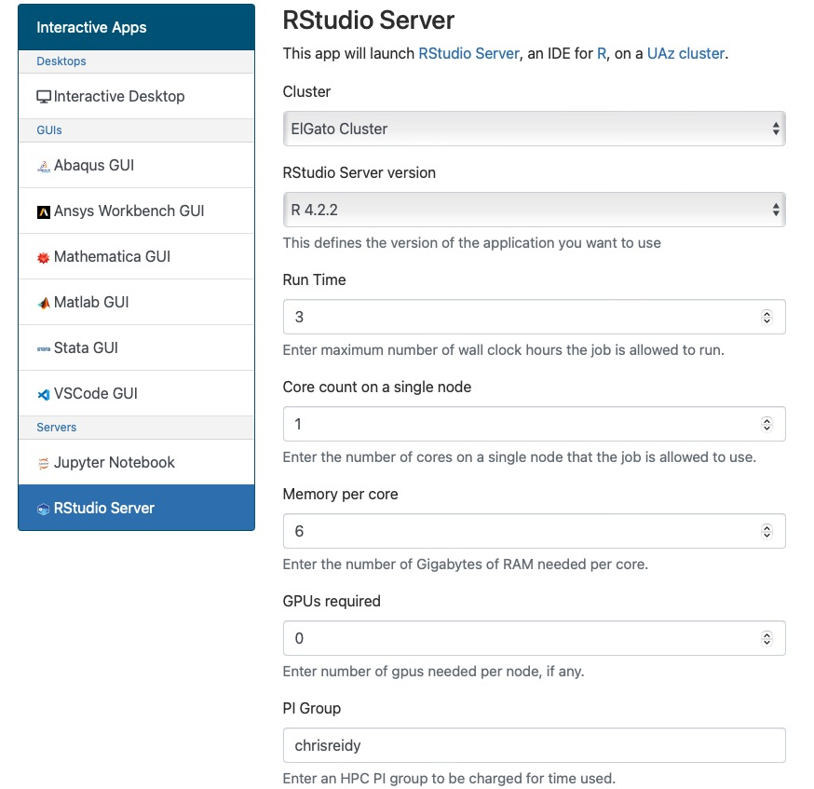
Using RStudio on HPC

Slide 22
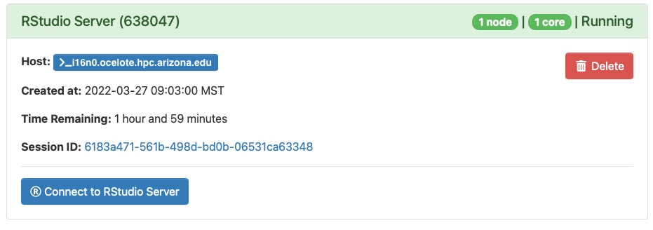
Using RStudio on HPC

Slide 23
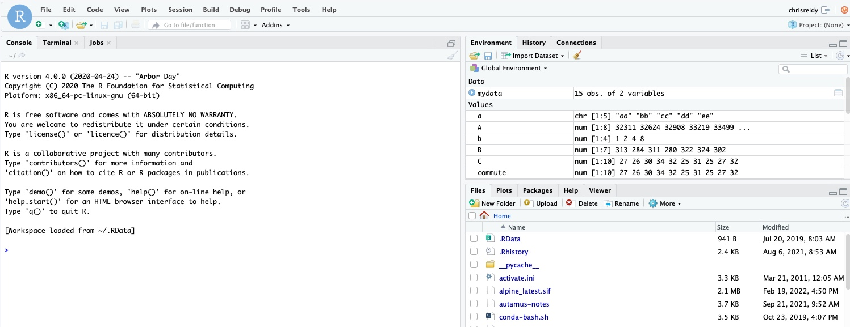
Using RStudio on HPC

Slide 24
Exercise: Data Pre-processing
In this exercise, download package VIM and mice. The dataset 'sleep' is included in the package VIM. It comes from a study about the sleeping pattern of 62 mammals. It wants to identify the relationships between sleep, and some physical characteristics of mammals, such as brain and body weight, life span, gestation time, time sleeping, and predation and danger indices.
# install package “VIM”
install.packages("VIM") # Hint: use multiple cores. It goes much faster
# To use the package in an R session, we need to load it in an R session via
library()
library(VIM)
# Load dataset “sleep”, which comes within the package “VIM”
data(sleep, package ="VIM")
# call function head() to get a feeling about data, or call sleep to see all values
head(sleep)
# download package “mice” and load it into R
install.packages("mice")
library(mice)

Slide 25
Exercise: Data Pre-processing
In R, we use “NA” stands for missing value; NaN(Not a Number) stands for an impossible value; And symbol “Inf” and “-Inf” stands for infinity and negative infinity respectively. In order to tell whether a value belongs to any case above, we use function is.na(), is.nan(), and is.infinite(). The return value of each function is Boolean
First, we need to know how many rows in “sleep”
nrow(sleep)
## [1] 62
# We use complete.cases() or na.omit() to see tuples without missing value.
sleep[complete.cases(sleep),]
# or try
na.omit(sleep)
# Count the number of rows without missing value
nrow(sleep[complete.cases(sleep),])
## [1] 42
# To reverse the condition logic (rows containing one or more missing value), we use the exclamation mark highlighted in Red
sleep[!complete.cases(sleep),]
nrow(sleep[!complete.cases(sleep),])
## [1] 20

Slide 26
Exercise: Data Pre-processing
We tell R a Boolean value by inputting a TRUE or a FALSE. However, R can treat them as integer 1 or 0 respectively, which means information about missing value can be captured by using function sum() and mean().
# Check how many observations contain missing value in column “Dream”
sum(is.na(sleep$Dream))
## [1] 12
# About 19% of obs (observations) in column Dream contain missing value
mean(is.na(sleep$Dream))
## [1] 0.1935484
# 32% obs in data frame sleep containing one or more missing value
mean(!complete.cases(sleep))
## [1] 0.3225806

Slide 27
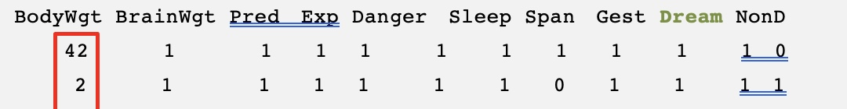
Exercise: Data Pre-processing
Checking missing values is important, but little information about distribution and pattern can be observed via functions we called above. It will be a convenient alternative if we can see how the missing values distribute in datasets. To do so, we can use the function md.pattern() to generate a matrix that shows the pattern of missing value.
# call function md.pattern(). Make sure you loaded package mice into R first
md.pattern(sleep)

Slide 28
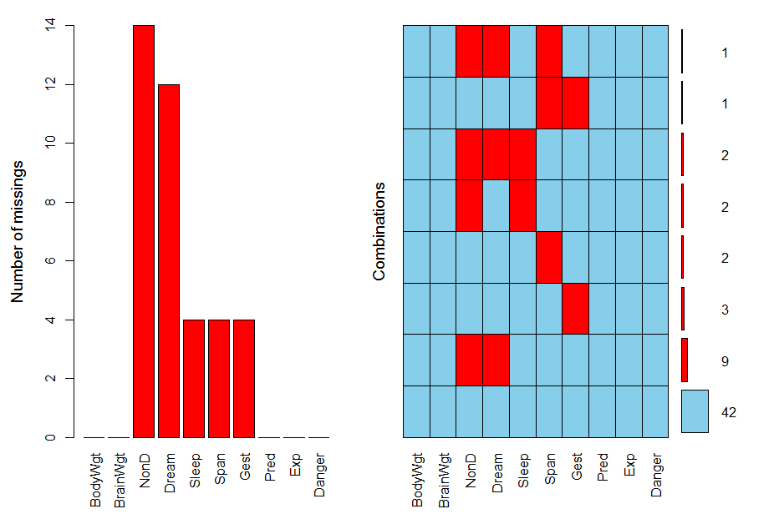
Exercise: Visualization – aggr
Instead of seeing the sleep data in table via function md.pattern(), a visualization usually makes more sense to users. The package VIM provides several functions that visualize the pattern of missing values. Here we will apply aggr(), to our dataset.
# call function aggr (), prop = FALSE convert percentage value into counts
aggr(sleep, prop = FALSE, numbers = TRUE)

Slide 29
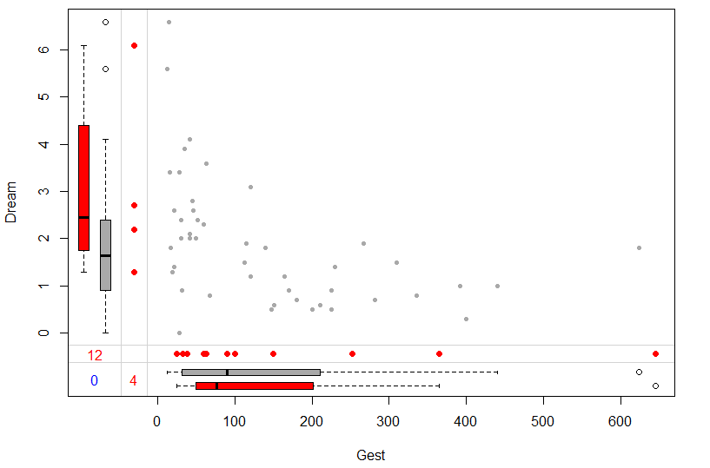
Exercise: Visualization - marginplot
Function marginplot() returns a scatter chart, where we can observe the relationship between two variables.
# call function marginplot (), pch indicates notation of obs, col tells R how you would like to see results in different color
marginplot(sleep[c("Gest", "Dream")], pch=c(20),
col = c("darkgray","red","blue") )

Slide 30
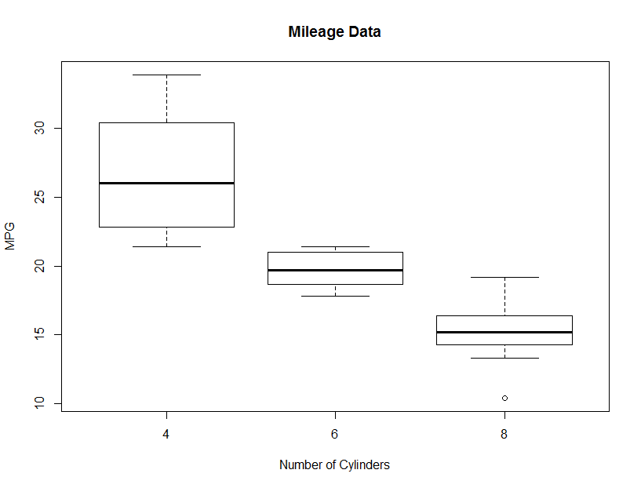
Exercise: Visualization - boxplot
Load dataset mtcars into R and show relationship between mpg and # of cylinders
boxplot(mpg ~ cyl, # mpg is the target variable
# cyl is the explanatory variable
data = mtcars,
col = "grey",
main = "Mileage Data",
ylab = "MPG",
xlab = "Number of Cylinders" )
Maximum
IQR – Inter Quartile Range
Minimum
Whisker
Outlier

Slide 31
Exercise: Visualization – violin plot
A violin plot provides a comprehensive chart that combines information in box plot and density distribution.
install.packages(“vioplot”)
library(vioplot)
v1 <- mtcars$mpg[mtcars$cyl == 4]
v2 <- mtcars$mpg[mtcars$cyl == 6]
v3 <- mtcars$mpg[mtcars$cyl == 8]
# draw violin plots for vectors
vioplot(v1,v2,v3,
names=c(“4 cylinders”, “6 cylinders”, “8 cylinders”),
col=“gold”)

Slide 32
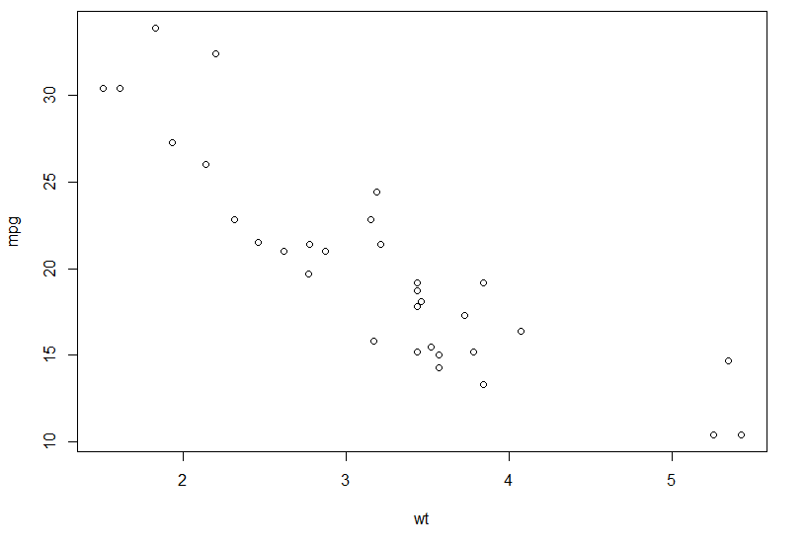
Exercise: Visualization – scatter plot
Using mtcars again we apply dot plot to check how each observation is distributed in a given sample space.
plot(mpg ~ wt, data = mtcars)

Slide 33
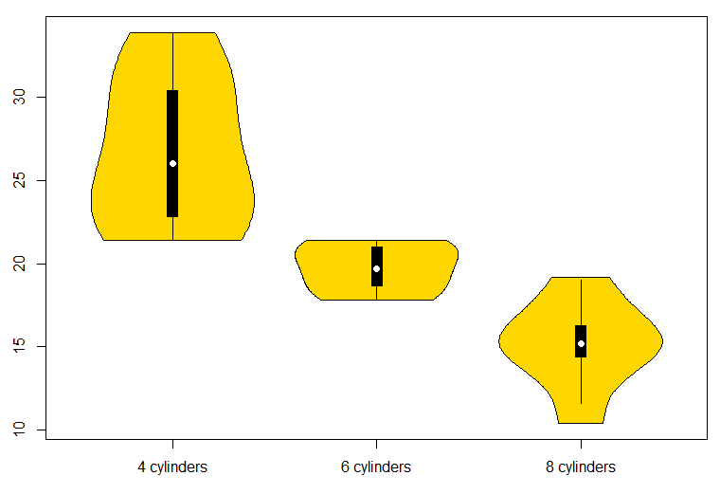
Exercise: Visualization – violin plot
The outline of a violin chart indicates the density of distribution. The black bar at center tells the IQR of distribution.

Slide 34
Exercise: Naive Bayes Classifier
Installing Packages
In the Mushroom dataset, there are 8123 observations belonging to 23 species of gilled mushrooms in the Agaricus and Lepiota Family. There are two types of mushroom in terms of edibility. If classes=e, the mushroom is edible, if classes=p, the mushroom is poisonous. We want to tell which mushrooms are edible from those poisonous by looking at some of their characteristics. Source: University of California Irvine
View working directory then set working directory
e1071 – This is the dataset we are going to use.
getwd()
setwd(‘/xdisk/chrisreidy/workshops’)
install.packages(‘e1071’)
library(e1071)

Slide 35
Exercise: Naive Bayes Classifier
Preprocessing
Save Mushroom.csv under your working directory. The null value in mushroom dataset is denoted by question mark.
# read in csv file mushroom.csv. Note the question mark represents null value
mushroom <- read.csv(“Mushroom.csv”, na.strings = “?”)
summary(mushroom)
# check completion
nrow(mushroom[!complete.cases(mushroom),])
## [1] 2480

Slide 36
Exercise: Naive Bayes Classifier
Preprocessing
Naive Bayes is an algorithm that depends on probability. To predict a conditional probability, we have to figure out the prior probability of each predictive variables. Therefore, a dataset with null value will raise risk for our prediction
# we can retain observations that do not contain NA(null) value
mushroom = mushroom[complete.cases(mushroom),]

Slide 37
Exercise: Naive Bayes Classifier
Training and testing sets
Next, we will create train and test sets of the data. We will fit the model with the training
set, and use the test set to evaluate the model. We will do a 70/30 split (70% will be training data).
# 70% of original data will be used for training
sample_size <- floor(0.7 * nrow(mushroom))
# randomly select index of observations for training
training_index <- sample(nrow(mushroom), size = sample_size, replace = FALSE)
train <- mushroom[training_index,]
test <- mushroom[-training_index,]

Slide 38
Exercise: Naive Bayes Classifier
Fitting and Model Performance
There is a Naive Bayes classifier in the e1071 package, loaded into our current session already via function library(e1071). Fit the model to the training data.
# note the period coming after tilde. It means all the other variables in that dataset will be predictive variable
mushroom.model <- naiveBayes(classes ~ . , data = train)
# We can explore the detail conditional probabilities for each variables by calling the object mushroom.model itself.
mushroom.model

Slide 39
Exercise: Naive Bayes Classifier
Fitting and Model Performance
After fitting, run the test data through the model to get the predicted class for each observation.
# The result of prediction, a vector, will be attached to test set labelled as “class”. The return of prediction is a vector including predicted type of mushroom
mushroom.predict <- predict(mushroom.model, test, type = “class”)

Slide 40
Exercise: Naive Bayes Classifier
Fitting and Model Performance
Show the performance of the model.
# pick actual value and predicted value together in a dataframe called results
results <- data.frame(actual = test[,'classes'], predicted = mushroom.predict)
# We can get a popular matrix called confusion matrix
table(results)
# columns indicate the number of mushrooms in actual type; likewise, rows indicate the number those in predicted type.
predicted
actual edible poisonous
edible TN=1067 FP= 2
poisonous FN= 46 TP=580

Slide 41
Exercise: Neural Network
Installing Packages
For this example, we need to install package ISLR. The data we will use is a built-in dataset of ISLR called College Data Set. It has several features of a college and a categorical column indicating whether or not the School is Public or Private.
ISLR – This is the dataset we are going to use.
caTools – We will use the caTools package to randomly split the data into a training set and test set.
neuralnet – This package contains the function about neural network neuralnetwork().
install.packages('ISLR')
install.packages('caTools')
install.packages('neuralnet')

Slide 42
Exercise: Neural Network
Loading Data
Install package ISLR, which is a dataset package and contains data we will use - College.
library(ISLR)
print(head(College, 2))
Private Apps Accept Enroll Top10perc
Abilene Christian University Yes 1660 1232 721 23
Adelphi University Yes 2186 1924 512 16
Top25perc F.Undergrad P.Undergrad Outstate
Abilene Christian University 52 2885 537 7440
Adelphi University 29 2683 1227 12280
Room.Board Books Personal PhD Terminal
Abilene Christian University 3300 450 2200 70 78
Adelphi University 6450 750 1500 29 30
S.F.Ratio perc.alumni Expend Grad.Rate

Slide 43
Exercise: Neural Network
Preprocessing
It is important to normalize data before training a neural network on it. The neural network may have difficulty converging before the maximum number of iterations allowed if the data is not normalized. There are a lot of different methods for normalization of data. Normally it is better to scale the data from 0 to 1, or -1 to 1. We can specify the center and scale as additional arguments in the scale() function. For example:
# Create Vector of Column Max and Min Values
maxs <- apply(College[,2:18], 2, max)
mins <- apply(College[,2:18], 2, min)
# Use scale() and convert the resulting matrix to a data frame
scaled.data <- as.data.frame(scale(College[,2:18], center = mins,
scale = maxs - mins))

Slide 44
Exercise: Neural Network
Preprocessing - continued
# Check out results
print(head(scaled.data,2))
Apps Accept Enroll
Abilene Christian University 0.03288692646 0.04417701272 0.10791253736
Adelphi University 0.04384229271 0.07053088583 0.07503539405
Top10perc Top25perc F.Undergrad
Abilene Christian University 0.2315789474 0.4725274725 0.08716353479
Adelphi University 0.1578947368 0.2197802198 0.08075165058
P.Undergrad Outstate Room.Board
Abilene Christian University 0.02454774445 0.2634297521 0.2395964691
Adelphi University 0.05614838562 0.5134297521 0.7361286255
Books Personal PhD
Abilene Christian University 0.1577540107 0.2977099237 0.6526315789
Adelphi University 0.2914438503 0.1908396947 0.2210526316
Terminal S.F.Ratio perc.alumni
Abilene Christian University 0.71052631579 0.4182305630 0.1875
Adelphi University 0.07894736842 0.2600536193 0.2500

Slide 45
Exercise: Neural Network
Train and Test Split
Let us now split our data into a training set and a test set. We will run our neural network on the training set and then see how well it performed on the test set.
We will use the caTools package to randomly split the data into a training set and test set.
# Convert Private column from Yes/No to 1/0
Private = as.numeric(College$Private)-1
data = cbind(Private, scaled.data)
library(caTools)
set.seed(101) # sets random numbers
# Create Split (any column is fine)
split = sample.split(data$Private, SplitRatio = 0.70)
# Split based off split Boolean Vector
train = subset(data, split == TRUE)
test = subset(data, split == FALSE)

Slide 46
Exercise: Neural Network
Neural Network Function
Before we actually call the function, we need to create a formula to insert into the machine learning model. The neuralnetwork() function won't accept the typical decimal R format for a formula involving all features (e.g. y ~ .). However, we can use a simple script to create the expanded formula and save us some typing:
feats <- names(scaled.data)
# Concatenate strings
f <- paste(feats,collapse=' + ')
f <- paste('Private ~', f)
# Convert to formula
f <- as.formula(f)
f
## Private ~ Apps + Accept + Enroll + Top10perc + Top25perc + F.Undergrad +
## P.Undergrad + Outstate + Room.Board + Books + Personal +
## PhD + Terminal + S.F.Ratio + perc.alumni + Expend + Grad.Rate
library(neuralnet)
nn <- neuralnet(f, train, hidden = c(10,10,10), linear.output = FALSE)

Slide 47
Exercise: Neural Network
Predictions and Evaluations
Now let's see how well we performed! We use the compute() function with the test data (just the features) to create predicted values. This returns a list from which we can call net.result
# Compute Predictions off Test Set
predicted.nn.values <- compute(nn, test[2:18])
# Check out net.result
print(head(predicted.nn.values$net.result))
[,1]
Adrian College 1
Alfred University 1
Allegheny College 1
Allentown Coll. of St. Francis de Sales 1
Alma College 1
Amherst College 1

Slide 48
Exercise: Neural Network
Predictions and Evaluations
Notice we still have results between 0 and 1 that are more like probabilities of belonging to each class. We'll use sapply() to round these off to either 0 or 1 class so we can evaluate them against the test labels.
predicted.nn.values$net.result <- sapply(predicted.nn.values$net.result,
round, digits = 0)
Now let's create a simple confusion matrix:
table(test$Private, predicted.nn.values$net.result)
Predicted No Predicted Yes
Actual No TN = 55 FP = 9
Actual Yes FN = 6 TP = 163

Slide 49
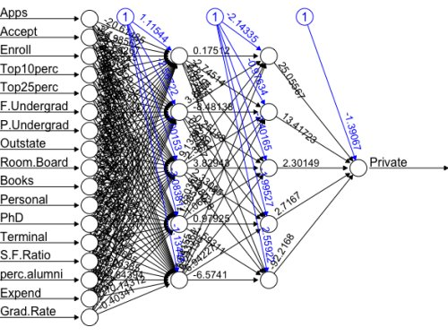
Exercise: Neural Network
Visualize
We can visualize the Neural Network by using the plot(nn) command. The black lines represent the weighted vectors between the neurons. The blue line represents the bias added. Unfortunately, even though the model is clearly a very powerful predictor, it is not easy to directly interpret the weights. This means that we usually have to treat Neural Network models more like black boxes.
plot(nn)

Slide 50
Exercise: Accuracy Terminology
Predicted No Predicted Yes
Actual No TN = 55 FP = 9
Actual Yes FN = 6 TP = 163
Starting with the confusion matrix:
True Positive is bottom right cell divided by sum of bottom row
TP is also called Sensitivity or Recall or “did I correctly predict positive?”
True Negative is top left divided by sum of top row; also called Specificity
FP <- 1 – TN
FN <- 1 – TP : Percent of observations in negative class
Precision is True Positive / Total Positive
F <- 2 * precision * recall / (precision + recall) - aka balanced mean
Receiver Operating Characteristic Curve (ROC) – measures Sensitivity (TP) to Specificity (TN). Visually, closer to right angle is better than diagonal.

